Slide 1
A Comparison of Hybrid and Statistical Forecasting Techniques for Short-Term Energy Demand Forecasting
Matthew Ingram
Department of Computer Science,
Durham University
Notes:
1. Okay, let’s begin. My project is entitled … and I’d like to begin by [CHANGE]

Slide 2
Notes:
… explaining the motivation this study.
As I’m sure we’re all aware, there is an ever increasing need to reduce our collective carbon footprint, through the increased uptake of renewable energies such as wind power.
However, due to our inability to accurately predict short term energy demand, highly polluting fossil fuel plants must provide what is known as the operating reserve – the unused extra capacity that can be activated in the event of unexpected surges in demand.
A study in 2011 by Matthias Fripp of the Environment Change Institute at the UoO, found that the operating reserves typically undo up to 6% of the greenhouse gas emissions savings that would otherwise be expected from windpower alone
Therefore, there is a genuine need to improve the accuracy of our short term energy demand forecasts
~ 1 minute

Slide 3
Overview
Introduction
The aim of this project was to compare the performance of a state-of-the-art hybrid forecasting model with traditional statistical forecasting techniques
The hybrid model combines an Exponential Smoothing (ES) model with a dilated Long Short-Term Memory (LSTM) neural network
Improvements in short-term energy demand forecasting can reduce the reliance on highly-polluting coal plants
Challenges
Even on an aggregated level, energy demand can be highly stochastic as it is driven by the climate and human behavior
Machine learning models are typically poor at univariate forecasting
Notes:
Introduction
As stated in the title of the project… - the winner of a recent international time series forecasting competition, developed by Slawek Smyl of Uber technologies – with classical statistical forecasting techniques.
The model is hybrid in the sense that it combines an Exponential Smoothing component - an exising statistical model – with a dilated long short term memory neural network. The model aims to utilise the benefits of each whilst seemingly avoiding their shortcomings.
The hope is that by applying the model to the specific task of energy demand forecasting, our forecasting ability will improve, and a reduction in carbon emissions will be seen
Challenges
We faced several challenges during the project. The first being that… highly unpredictable, as it is fundamentally driven by human behaviour and influenced strongly changes in the weather.
Furthermore, machine learning models such as the one used in the hybrid model, are typically poor at performing univariate forecasting.
~ 2minutes 30 seconds
We show in our results that in the long run such a naïve forecast is optimal
Tenses - should it all be 'was'
Person - I or We

Slide 4
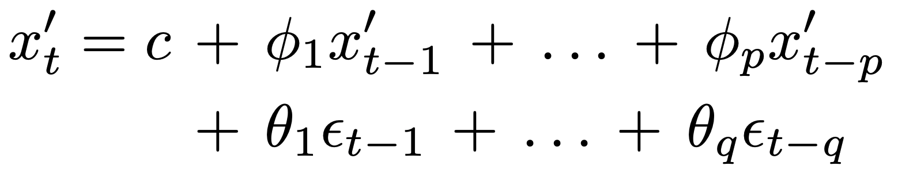
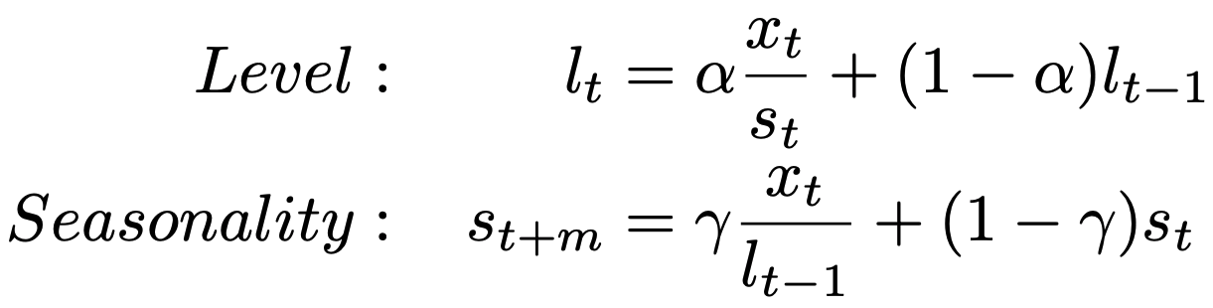
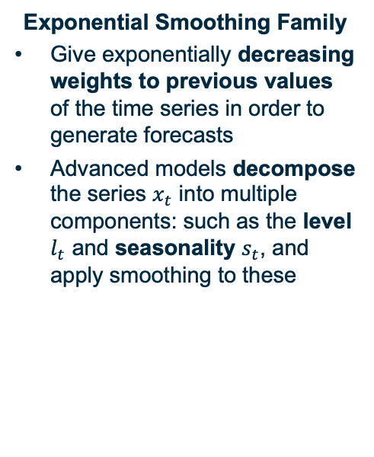
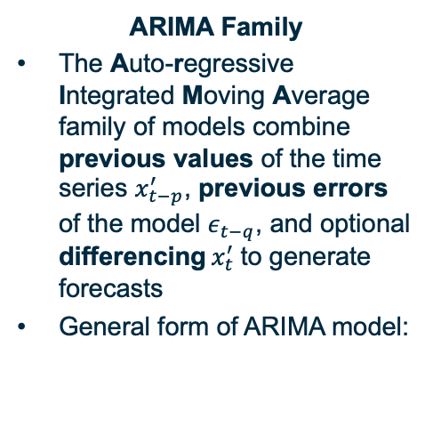
Statistical Benchmark Models
ARIMA Family
The Auto-regressive Integrated Moving Average family of models combine previous values of the time series $x_{t−p}^{′}$, previous errors of the model $ε_{t−q}$, and optional differencing $x_{t}^{′}$to generate forecasts
General form of ARIMA model:
Exponential Smoothing Family
Give exponentially decreasing weights to previous values of the time series in order to generate forecasts
Advanced models decompose the series $x_{t}$ into multiple components: such as the level $l_{t}$ and seasonality $s_{t}$, and apply smoothing to these
Other Models
Multiple naïve models, which simply replicate recent (seasonal or non-seasonal) observations, are also included for comparison
The Theta method modifies the local curvature of the time series to magnify long term trends and minimise short term noise
Previous Values (AR)
‘Rolling mean’
Smoothing Coefficients
Differenced
Series (I)
Previous Errors (MA)
Variation due to ‘season’
Notes:
Before.. I’d first like to discuss the statistical models we used for comparison. These can be broadly split into three categories.
ARIMA
The …. Denoted by.. which are the auto-regressive terms, denoted by epsilon…which are the moving average terms. The differenced version of a time series gives the change between consecutive values, as opposed to the values themselves. The benefit of differencing is that it removes a linear trend from the time series
The general form of the model is thus as is shown here. The possibly differenced time series value is given by: a constant, plus a linear combination of the auto regressive terms, plus a linear combination of the moving average terms. The process of fitting the model deduces the values of these parameters
Exponential Smoothing
The second..
The common feature to all exponential smoothing models is that their predictions give exponentially decreasing weight to time series values which are further in the past, which can be thought of as smoothing the series
More complicated ES models decompose the series, denoted by… which can be effectively be thought of as a moving average, and the seasonality, which can be thought of as the amount the data point has varied from the level as a consequence of its position within the seasonal cycle. Just to expand on that and hopefully clear up any confusion, the dataset we consider in this paper shows weekly seasonality – this means that every data point is highly correlated with corresponding value from the previous week. As the dataset consists of hourly data, and there are 168 hours in a week, we equivalently refer to this as 168 hour seasonality. So here, the seasonality component represents the amount the data point has risen or fallen below the level as a consequence of the hour within the week it represents.
The formulae shown here are not important, but the concept of level and seasonality are used extensively in the hybrid model, so please bare these in mind.
Other Models
A number of other miscalleaous models were also included for comparison.
These include so-called naïve models, whose forecasts are simply equal to recently observed values, and also
The theta method. This method was included as it was the winner of the previous iteration of the international time series forecasting competition mentioned on the previous slide. The model aims
~ 5 minutes
which must be kept running to provide the spinning reserve

Slide 5
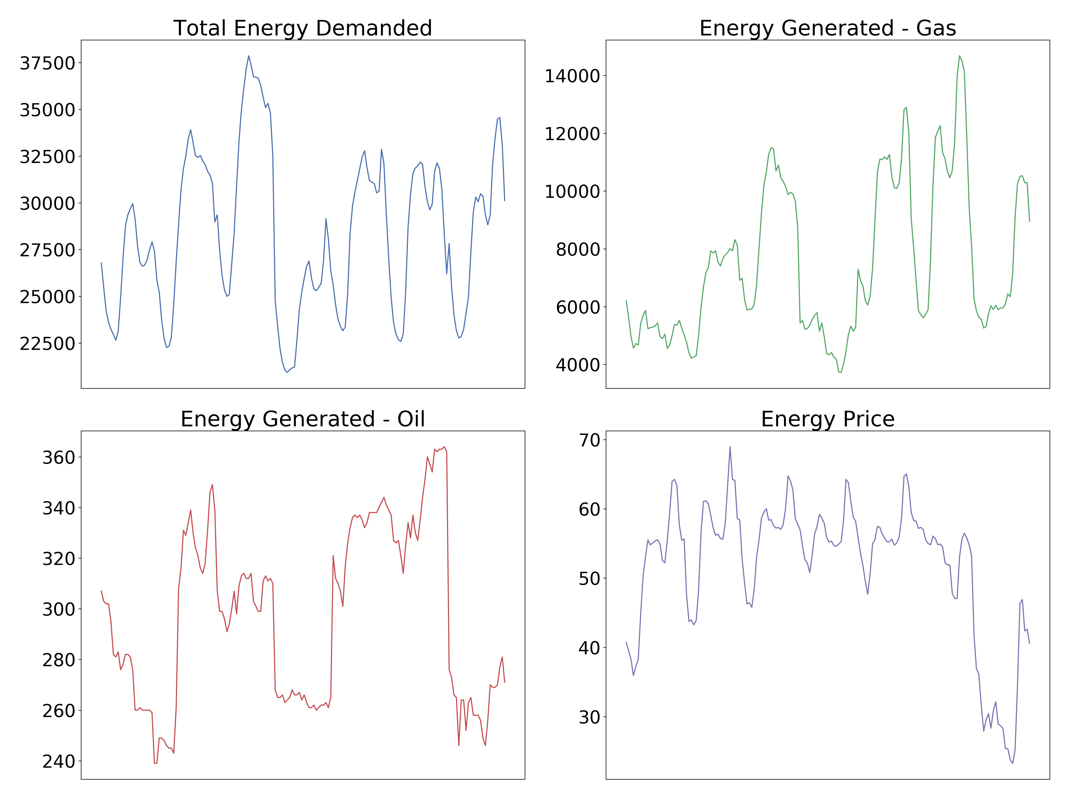
Notes:
Now, a key point to note before continuing is that the dataset we used consists of multiple time series. These time series represent the total energy demand – which is what we’re trying to predict and shown in the top left figure – but also other information such as how much energy was been generated throughout the day, stratified by the fuel type, and the price of energy. The key idea of the hybrid model is that the neural network component learns across multiple time series, in the hope that these other, related time series contain information that will aid the prediction of the total energy demand.

Slide 6
Hybrid ES-RNN Model – Overview
ES Component
The dataset consists of multiple time series
Each time series is fitted with an individual ES model
The fitted level and seasonality values are used to de-seasonalise the series
LSTM Component
The LSTM has dilated connections between seasonally separated values
The LSTM output passes through tanh and fully-connected layers to give an output of the correct length
Ensembling
Forecasts are taken from the final five training epochs and averaged to prevent overfitting
The entire training procedure is repeated three times and the forecasts averaged to further improve performance
5
Forecasting
1
2
3
4
Seasonalise
Individual
ES Models
Remove
Seasonality
Dilated
LSTM
Tanh & Linear
Layer
5
Training
Calculate
Loss
Notes:
The hybrid model has two key components, and also makes extensive use of ensembling, which I’ll defer talking about for now.
ES Component
The first component is the ES component. Now, as just mentioned, the dataset we used consists of multiple time series. Each of these time series is fitted with an individual ES model, identical to the one shown when discussing the statistical benchmark methods.
The process of fitting the ES model to the time series generates a level and seasonality value for each data point in the time series.
The time series values are divided by their corresponding seasonality and level values to remove the seasonal effects and normalise them into a suitbale range.
LSTM Component
The normalised series are then input into the LSTM. An LSTM is a type of recurrent neural network, which have been shown to be particularly well suited to the handling of sequential data. We used a modification of the standard LSTM which includes so-called dilated connections - these are just direct connections between seasonally separated values in the sequence, which hopefully aids the model in learning the sesasonality of the data
The output of the dLSTM then passes through a standard non-linear tanh layer, and finally through a fully connected linear layer which converts the LSTM output to a vector of the correct length – 48 hours in our case, as this is the horizon we are forecasting.
If we are training the model the loss is then calculated and the the parameters of the LSTM and the ES model are updated. On the other hand if we are forecasting, then the output is re-seasonalised and de-normalised, to give the final forecast.
Ensembling
The other key aspect of the model is its extensive use of ensembling. Ensembling is the practice of combining multiple forecasts in order to improve the overall accuracy of the model, and has been proven to work empirically in numerous papers. The hybrid model makes use of ensembling in two ways.
First, during training, forecasts are taken after each of the final 5 iterations and averaged, in order to prevent overfitting
Secondly, the entire training procedure is repeated three times. The forecasts from each of these repetitions are then averaged, to further improve the forecasting accuracy. In this way, each forecast is actually the average of 15 slightly different forecasts. As some of the model’s parameters are randomly initialised, we are effectively gauranteed some variation in each of these 15 forecasts.
Say this is how the original model was formulated, and we modifications of it
Key idea that deseasonalising shouldn’t be separate to the model itself

Slide 7
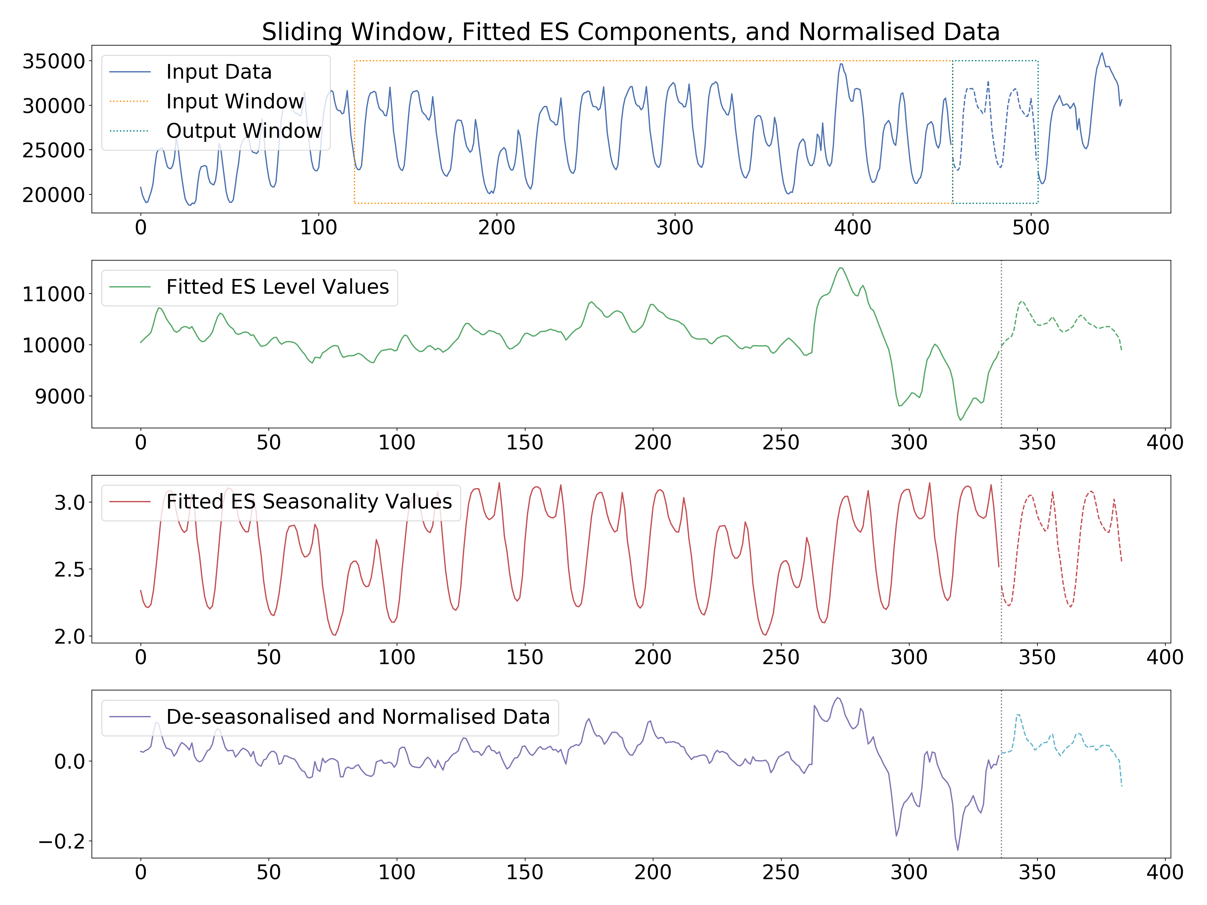
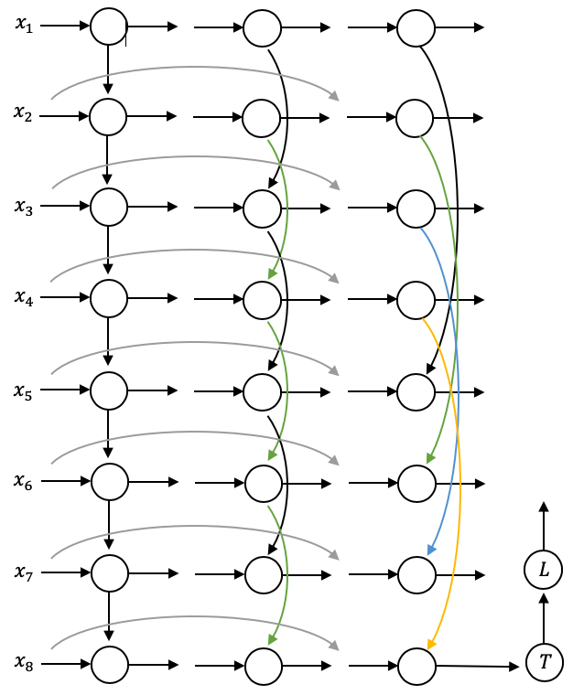
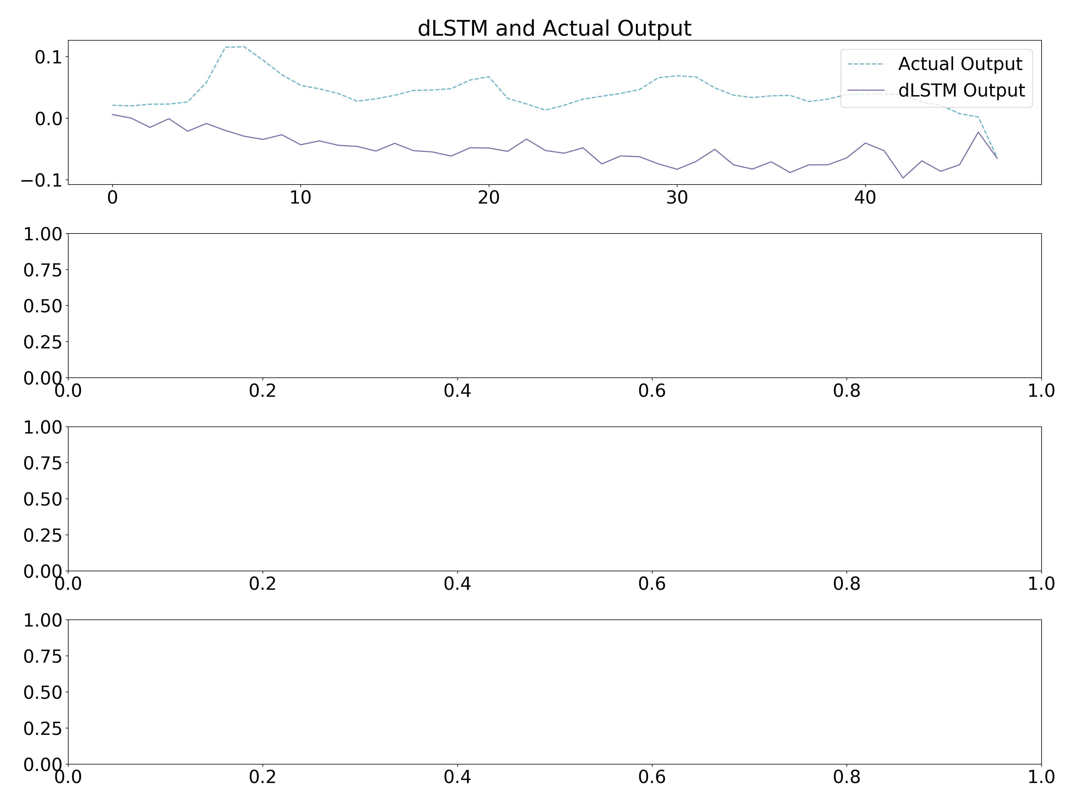
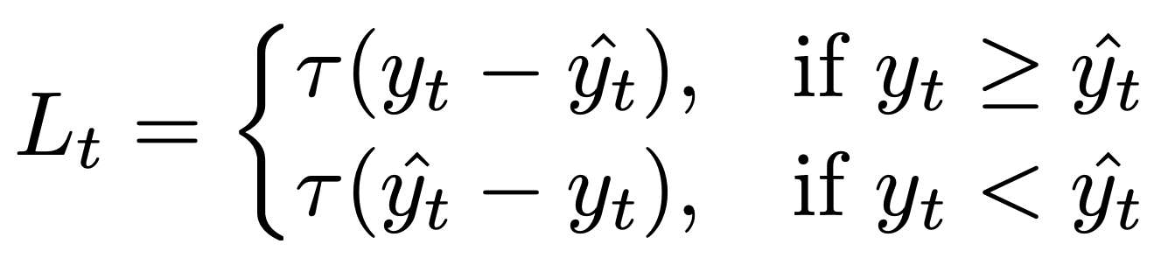
Hybrid ES-RNN Model – Training
ES Component
LSTM Component
Update Parameters
Backpropagation through time and gradient descent. Repeated for all series.
Notes:
We now discuss the details of the model, in particular how it is trained. In every training epoch, each of the time series is selected individually, and the procedure shown here is followed.
ES Component
We train the model using supervised learning, and so pairs of inputs and outputs (also known as targets), must be generated. In order to do this, a sliding window approach is used. A window of two weeks is placed over data, shown in the yellow dashed box on the top graph, and the values in this window form the input for this pair. The following 48 hours of data then forms the target, as shown in the grey dashed box.
Using the current values of the smoothing coefficients – which are unique to this time series – the ES model is then fitted to the data in both the input and the target windows. This generates a level and seasonality value for each data point, as shown in the second and third graphs. The solid line represents the values corresponding to the input, and the dashed line corresponds to the target. As you can see, the level is effectively a smoothed version of the series, and the seasonality component aims to capture the repeated weekly pattern.
Each data point within the input and target windows is then divided by its corresponding seasonality value to remove the seasonal effects from the data. Each value is then divided by the level value corresponding to the final input value, which normalises the data with respect to this value.
The resulting de-seasonalised, normalised input and target values are shown in the fourth graph.
The sliding windows are then moved forward one hour, and the next input, target pair is generated. This repeats along the entire length of the series, until we have an entire batch of input, target pairs.
LSTM Component
Each of the normalised inputs within the batch is then fed into the LSTM.
The LSTM is made up of multiple layers, and a simplified version of the LSTM is shown here. The first layer is just a standard LSTM layer. The outputs of this layer are then fed into the second layer. In this simple example, this second layer has dilated connections of order 2. This just means that the hidden value of every cell is input directly into the cell 2 after the current cell. In the real network used in the hybrid model, we include layers with dilations of order 24 and 168, in the hope that these direct connections will help the network learn the daily and weekly seasonality of the data.
The LSTM includes Res-Net style shortcuts, shown in grey, which have been shown to assist deep networks learn the correct input to target mapping. The theory behind these connections is covered in detail in the report.
The output of the LSTM is then fed through a non-linear tanh layer, and finally a linear layer to generate an output of the correct length.
Update Parameters
The output of the LSTM, and the target values for this input are shown on the upper right graph here. We now calculate the error for this input target pair.
We use a simple pinball loss function in the network, which is simply the positive difference between the output and target values, multiplied by a scaler which is included to prevent bias.
This process is repeated for each input, target pair within the batch, giving a total loss for the entire batch.
We then perform standard backpropagation through time, and update the parameters of the LSTM network and the smoothing coefficients of the ES model, with respect to this loss, using standard gradient decent.
This entire process is then repeated for each of the other time series in the dataset. Therefore, the exponential smoothing parameters are updated once per training epoch and remain local to each time series, whereas the parameters of the LSTM are updated for each of the time series, and thus are said to be global. As noted earlier, in this way it is hoped that the net will be able to learn across all of the related time series in the dataset.

Slide 8
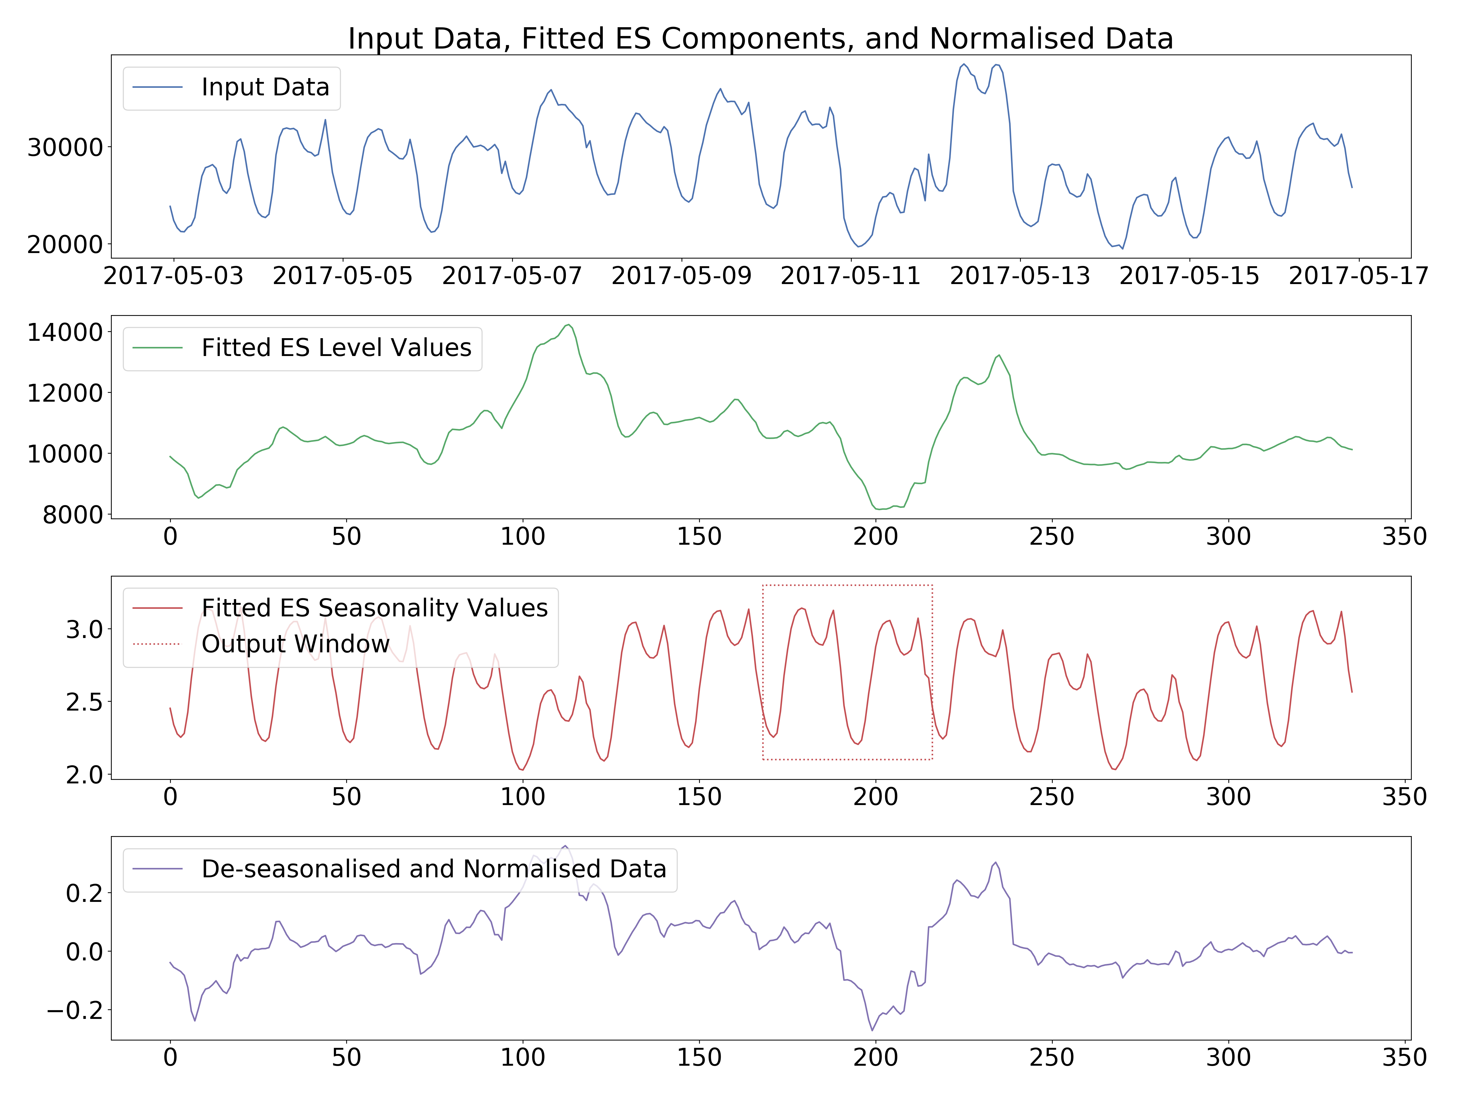
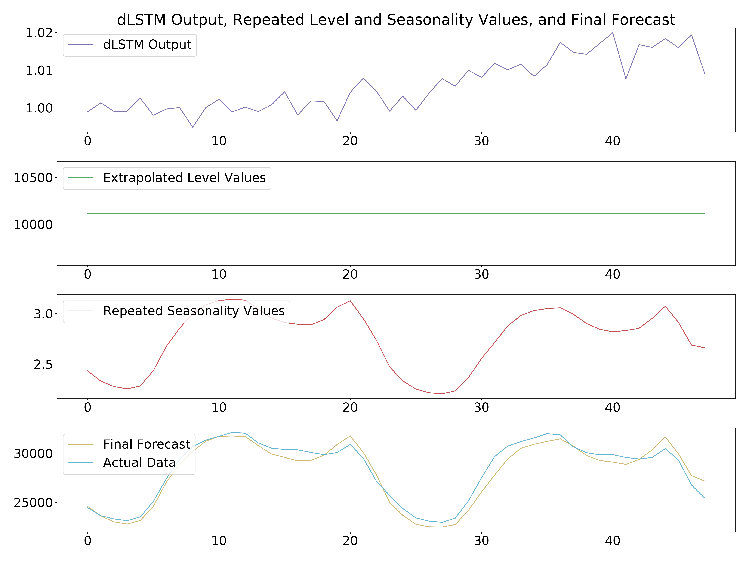
Hybrid ES-RNN Model – Generating a Forecast
ES Component
LSTM Component
Combine ES and LSTM
Notes:
Once the model has been trained, we can generate a forecast. To do so, a very similar procedure to the one used when training the model is used.
First, we take the very final window of input data from the training set, shown in blue here.
The fitted level and seasonality values corresponding to this data are saved in the model whilst training, and as before, we simply divide each data point by its corresponding seasonality value, and then by the final level value of the window, to de-seasonalise and normalise the data.
Again, this input is fed into the LSTM, and the output passes through the non-linear and linear layers. This gives the output which is shown in the top right graph.
We now need to de-normalise and re-seasonalise this output. To do so, we simply extrapolate the level from the input window, and repeat the seasonality values corresponding to the previous week of input data, shown in the dashed box here.
Finally, we multiply each value from the dLSTM output with its corresponding level and seasonality value, to generate the final forecast.
The final forecast is shown here, along with the actual data we were trying to predict. In this case, the model’s prediction was quite accurate.

Slide 9
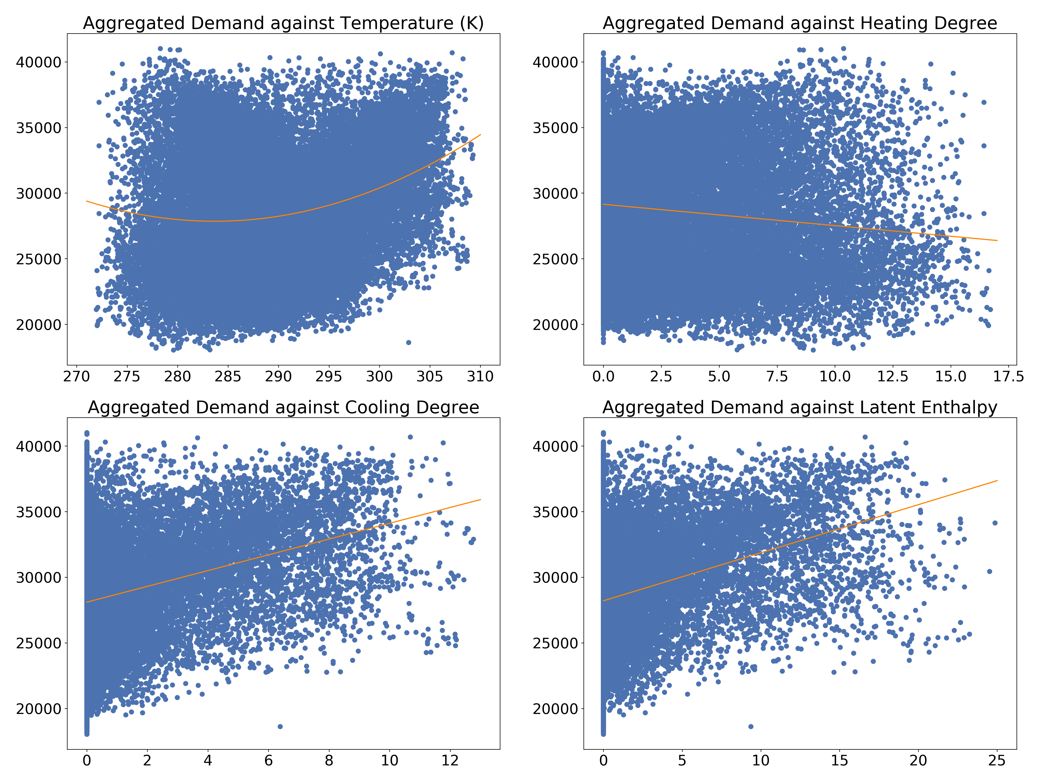
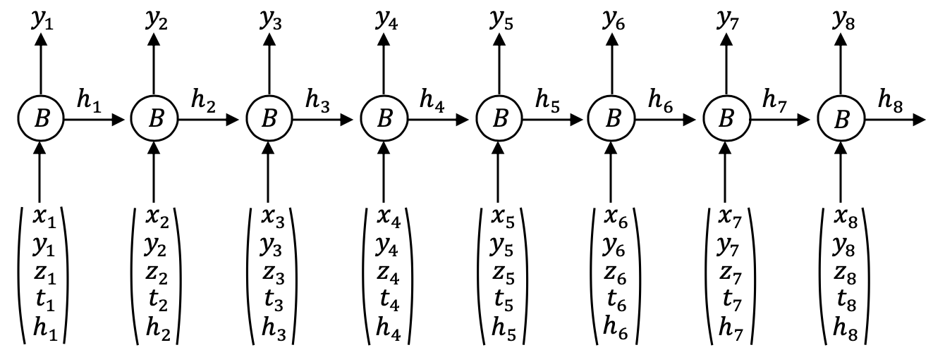
Hybrid ES-RNN Model – Extensions
Inclusion of Weather Information
The relationship between temperature and aggregated demand is highly non-linear
We extract three other metrics: the heating degree, the cooling degree and the latent enthalpy
We include the raw weather data and additional metrics as extra features in the LSTM
Modification of the Training Methodology
Rather than inputting the time series individually, we include them as additional features in the LSTM
Each time series is still allocated individual ES parameters

Slide 10
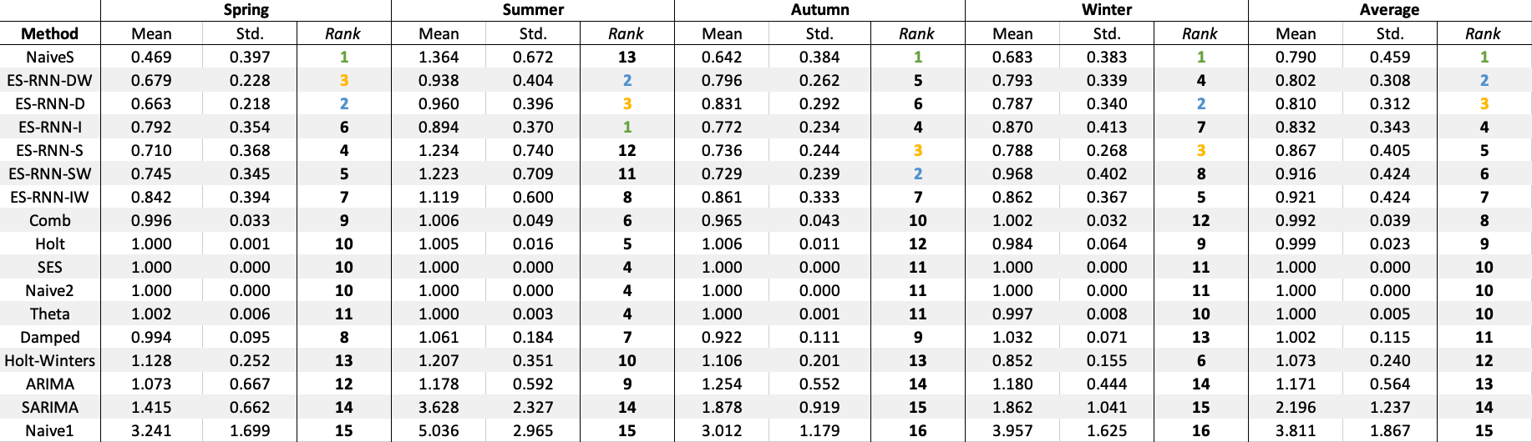
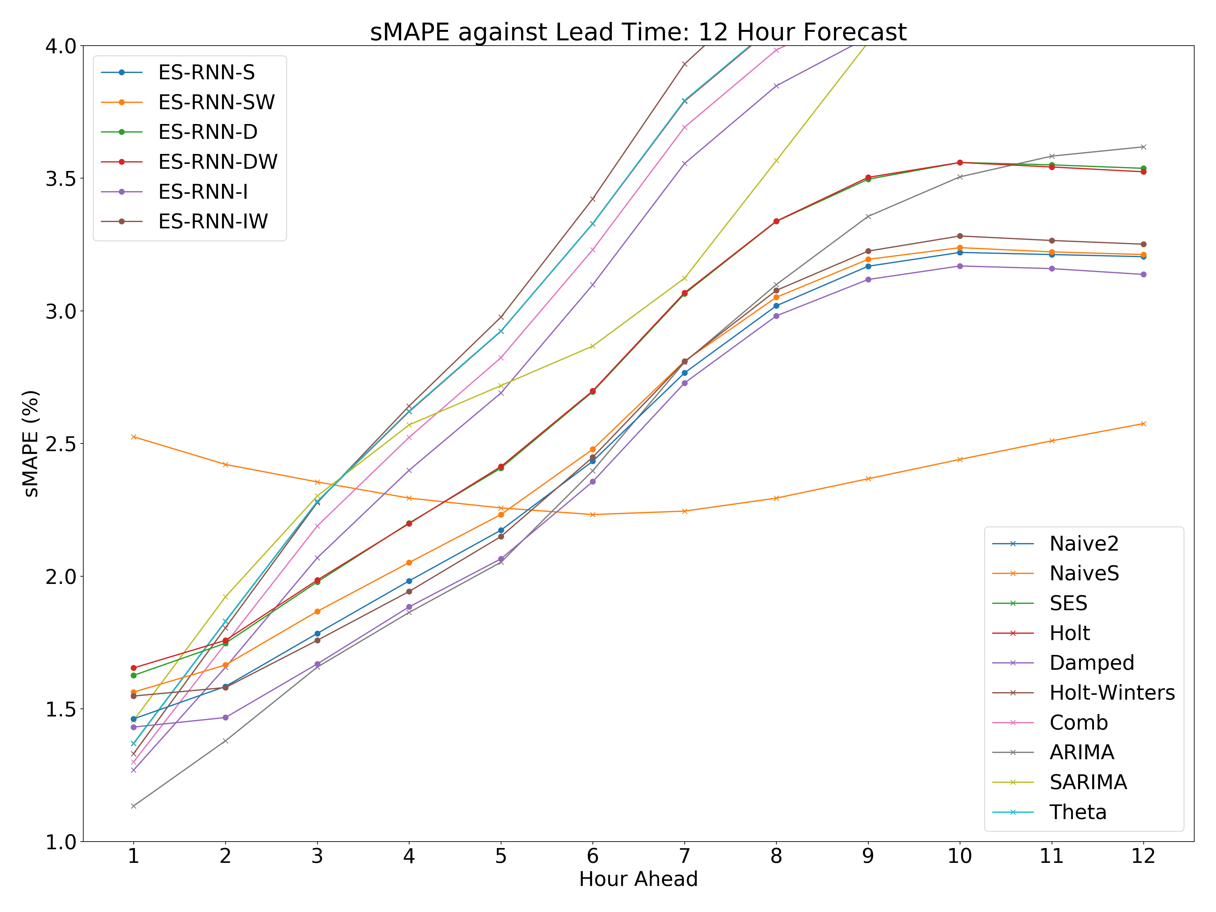
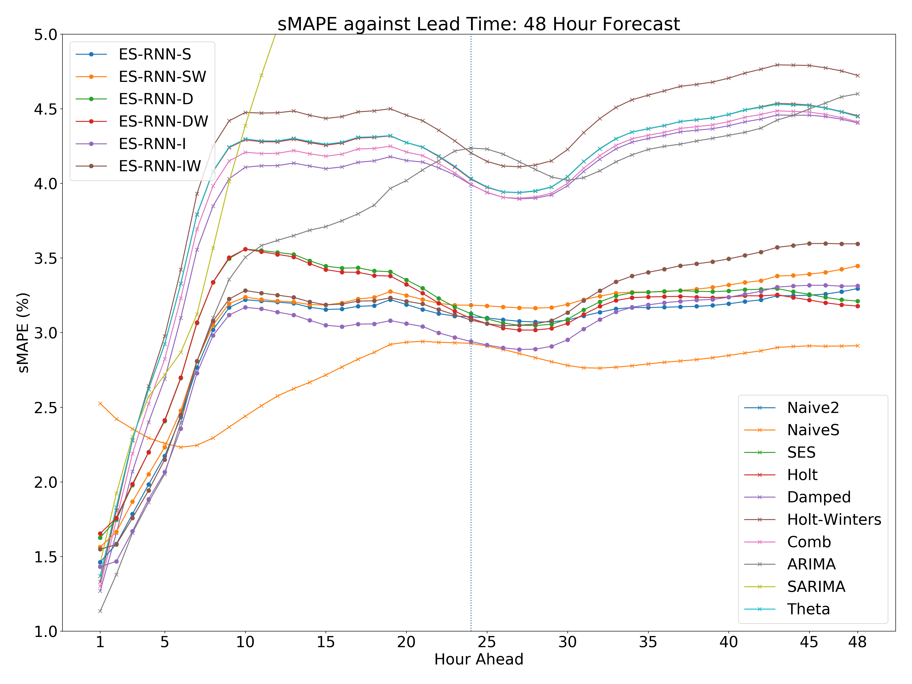
Experiments and Results
Experimental Methodology
We tested the models on four years of Spanish system-level hourly energy demand data
We split the data by year and by season, giving 16 series across which we averaged the models’ performance
Results
In the short-term, the ARIMA model performed optimally. In the longer-term, the NaiveS model performed well
The hybrid models performed consistently well across all horizons

Slide 11
Live Demonstration
Notes:
We show in our results that in the long run such a naïve forecast is optimal
Tenses - should it all be 'was'
Person - I or We

